Slide 1
Deep Learning for Finance Lab 2. Machine Learning + Python
Pablo-Manuel Calderón Gómez
2018

Slide 2
Machine Learning + Python
Index
Reading data.
Prepare and clean data.
Plotting data.
Histogram of daily returns.
Security characteristic line (alpha and beta).
Pearson Correlation coefficient
Calculate Portfolio value.
Portfolio DrawDown.
Sharpe ratio.

Slide 3
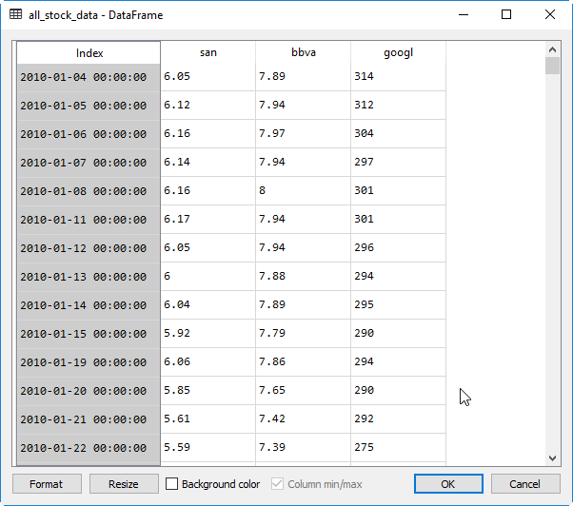
Machine Learning + Python
Reading data
In Python we use DataFrame objects to store data.
Each column of the data frame stores the data of an instrument.
DataFrame is defined with a range date index.
Read data into a data frame process:
1. Create a data frame with a range date index.
2. For each instrument:
2.1 Read data from csv files.
2.2 Remove lines with null (NaN).
2.3 Rename column data.
2.4 Adds data to data frame.

Slide 4
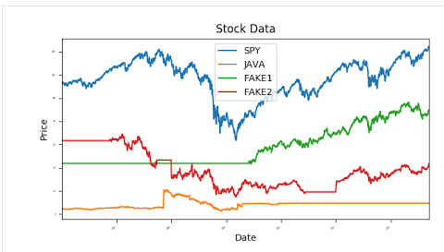
Machine Learning + Python
Prepare and clean data
We expect perfect free data with no gaps and missing values.
Reality is:
There are missing values (not all stocks trade every day).
We can have wrong values (negative values, not adjusted for dividends or splits).
Different values for an instrument depending on the data source.
Collect and store data requires time and money, we may need to buy data from providers.
Filling the gaps
If we interpolate in the zones without data we are giving ourselves information about the future. If we interpolate we are peeking into the future, and that is not allowed.
So we need to stick only filling forward a last known price.
1st Fill forward
2nd Fill backward (to start series at
same point)

Slide 5
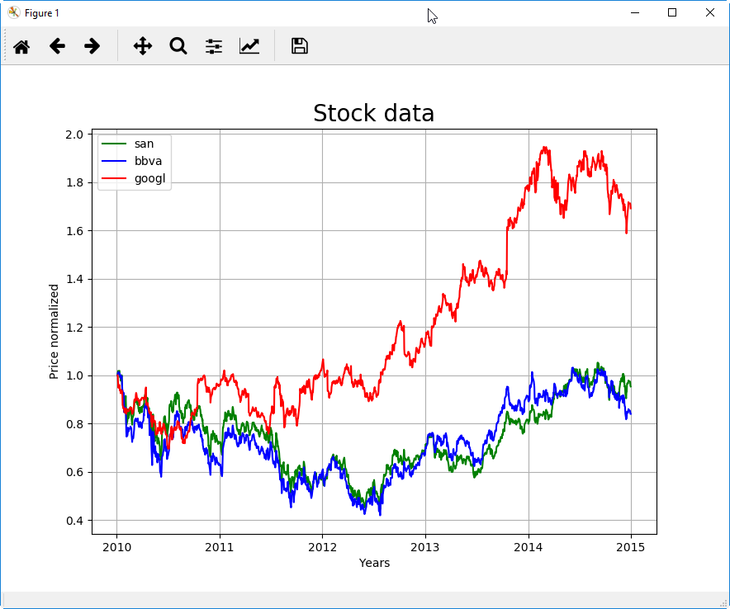
Machine Learning + Python
Prepare and clean data
To compare the price movement we need to normalize data. All values are divided by day1 value.

Slide 6
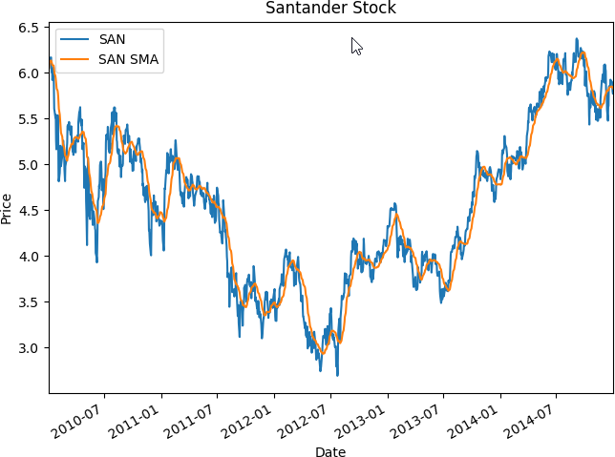
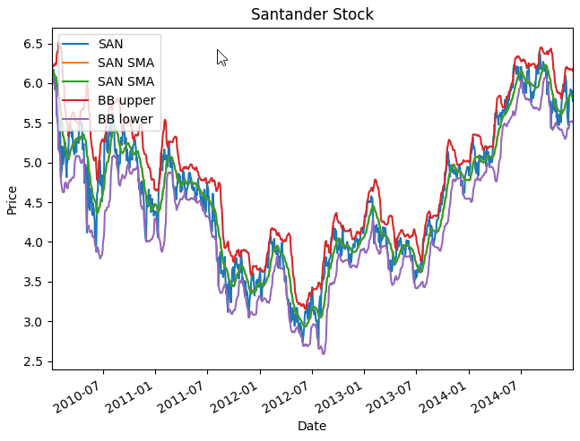
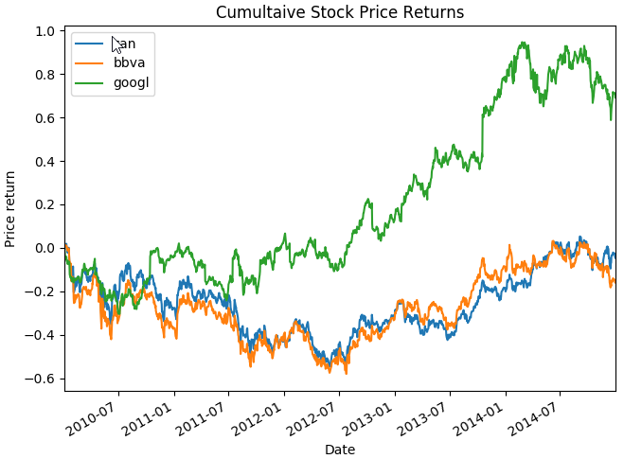
Machine Learning + Python
Plotting data
Python matplotlib.pyplot library.
Examples to present data:
Simple Moving Average.
Bollinger bands.
Cumulative Stock Price returns.

Slide 7
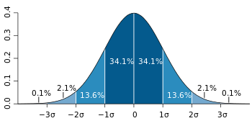
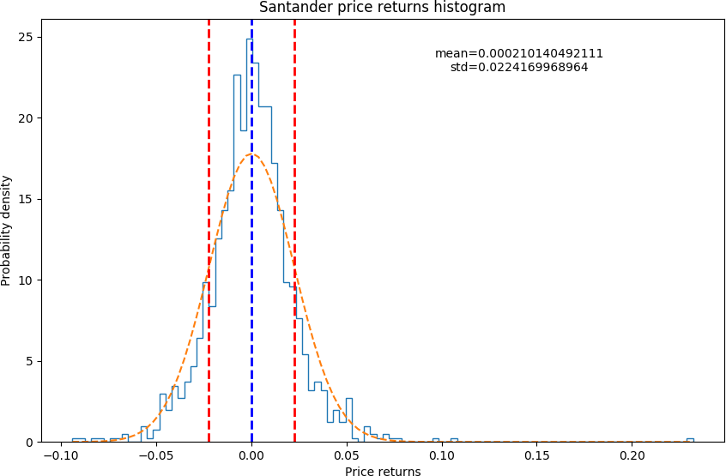
Machine Learning + Python
Histogram of daily returns
The next plot shows the histogram plot of the stock daily returns. Mean and standard deviation has been calculated and plotted.

Slide 8
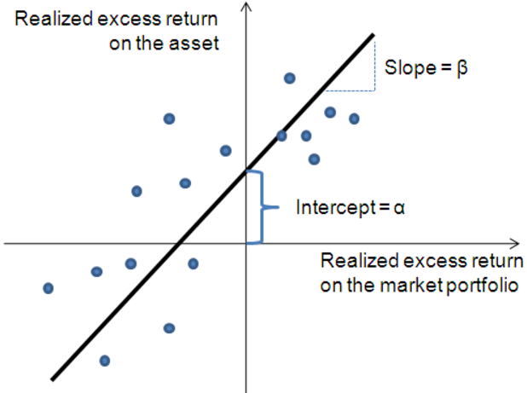
Machine Learning + Python
Security characteristic line
Security characteristic line (SCL) is a regression line (order 1), plotting performance of a particular portfolio against that of the market portfolio at every point in time.
The SCL is plotted on a scatter plot where the Y-axis is the return and the X-axis is the return of the market in general. The slope of the SCL is the beta and the intercept is its alpha.
Y = beta * X + alpha

Slide 9
Machine Learning + Python
Beta coefficient
The beta coefficient (slope) is a measure of the two series relation. In finance beta measures the volatility (risk) of an asset (the returns of the asset are compared to market returns).
Beta | Interpretation
β < 0 | Asset movement is in the opposite direction of the benchmark.
β = 0 | Asset movement is uncorrelated to the benchmark.
0 < β < 1 | Asset moves in the same direction, but in a lesser amount than the benchmark.
β = 1 | Asset moves in the same direction and in the same amount as the benchmark.
β > 1 | Asset moves in the same direction, but in a greater amount than the benchmark.

Slide 10
Machine Learning + Python
Alpha coefficient
The alpha coefficient (intercept) is a measure of the active return performance compared to a market index (or another data set).
In an efficient market, the expected value of the alpha coefficient is zero. Therefore, the alpha coefficient indicates how an investment has performed after accounting for the risk it involved.
Alpha | Interpretation
α < 0 | The investment has earned too little for its risk.
α = 0 | The investment has earned a return adequate for the risk taken.
α < 0 | The investment has a return in excess of the reward for the assumed risk.

Slide 11
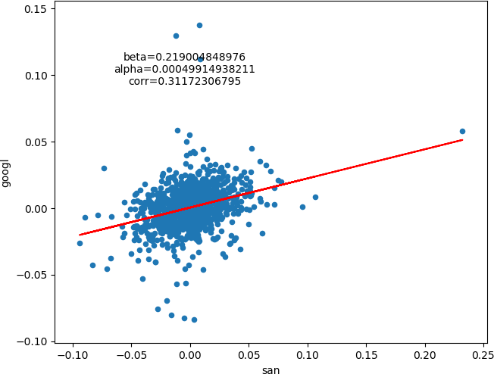
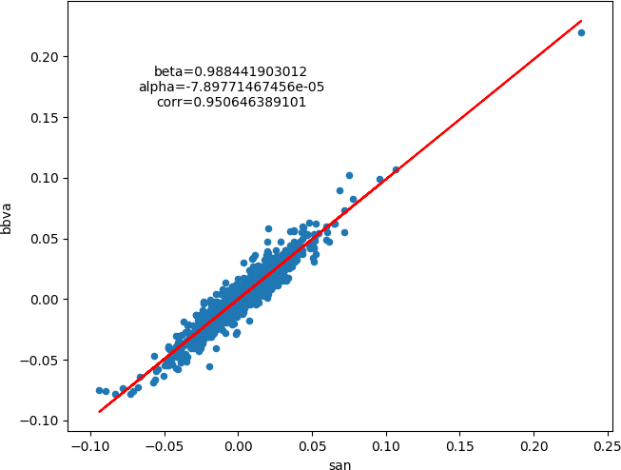
Machine Learning + Python
Correlation
Beta (slope) is not the correlation. Beta equal to 1 does not mean two series correlates. The correlation is when the points are close to the slope line independently of the slope value.
The plots shows the regression line coefficients between:
Santander and Google Santander and BBVA

Slide 12
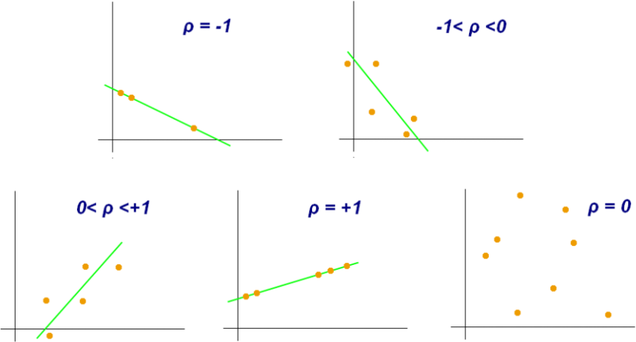
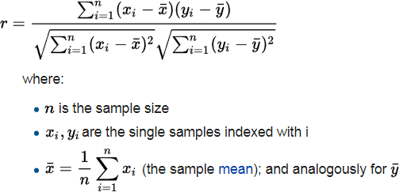
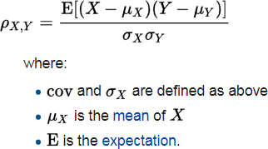
Machine Learning + Python
Pearson Correlation coefficient
The correlation is the dependence between two quantities. The most familiar method to measure the correlation is the Pearson correlation coefficient.
Pearson Coef. | Interpretation
pcc = 1 | Total positive correlation.
pcc = 0 | There is no linear correlation.
pcc = -1 | Total negative correlation.

Slide 13
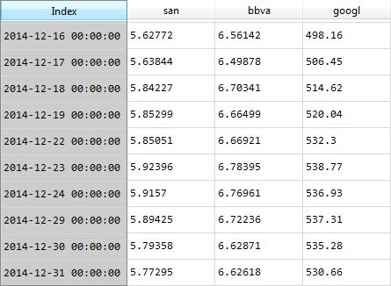
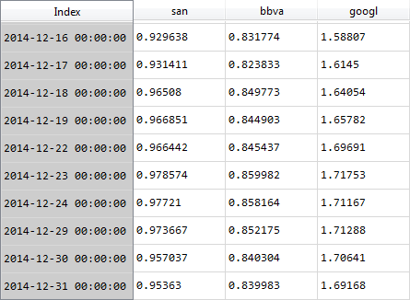
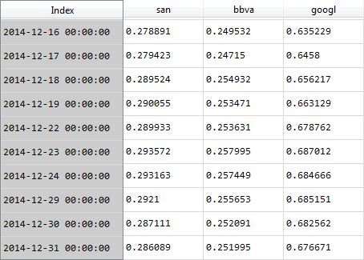
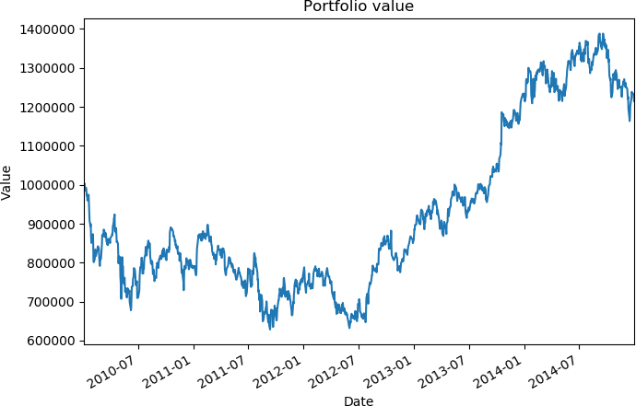
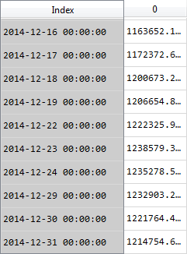
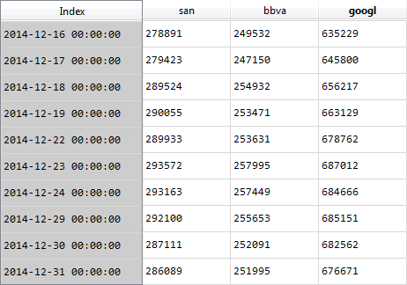
Machine Learning + Python
Portfolio
Process to calculate the portfolio value. 1. Normalize data. 2. Define portfolio allocation. 3. Calculate portfolio position. 4. Sum to calculate portfolio value.
All stock data
Normalize data
Portfolio allocation
30% 30% 40%
Amount allocated to the portfolio (x1M€)
Portfolio value
Portfolio position

Slide 14
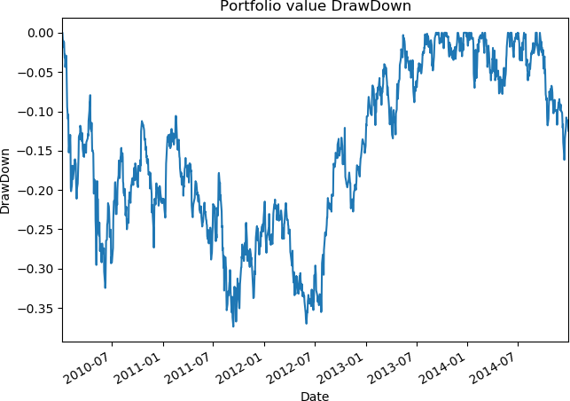
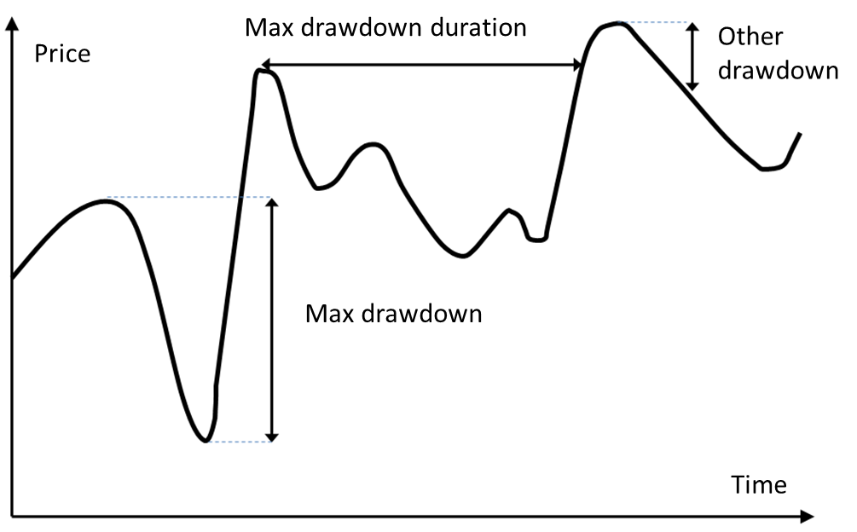
Machine Learning + Python
Portfolio DrawDown
A drawdown at given time t is defined as the difference between the current portfolio value and the global maximum of the portfolio value occurring before time t.
The code to calculate the portfolio drawdown value is: portfolio_value_drawdown = (portfolio_value / portfolio_value.cummax())-1.

Slide 15

Machine Learning + Python
Sharpe ratio
The Sharpe ratio characterizes how well the return of an asset compensates the investor for the risk taken. Higher Sharpe ratio provides better return for the same risk.
The ex-ante (before the event) Sharpe ratio is defined as:
Where Ra is the asset return, Rb is the return on a benchmark asset (risk free rate).
Sharpe ratio can vary depending on the sample. We apply a coefficient to correct the Sharpe Ratio with the sample size:

